Slide 1
Workforce Development Spotlight: February 2022 A Summary of Upcoming Career Compass and WFD Opportunities
New Content Coming Your Way!
Live Webinars Coming This Month
Taking Charge of Your Learning and Development (Continual Learning; Awareness/Basic) – 15 & 17 Feb
https://www.navfac.navy.mil/jobs/workforce-development/ccrc/emp_resources/comp_dev_content/continual-learning.html
SYSCOM Training Opportunities
NAVFAC Executive Coaching Program is open for enrollment from 1-11 Feb. This program includes (1) 360-assessment, (1) 360-assessment feedback session, and (14) 1-hour coaching sessions. Limited seats remain. More details: https://www.navfac.navy.mil/jobs/workforce-development/ccrc/emp_resources/executive-coaching.html
Please see the following page for additional opportunities. The Career Compass Event Calendar has been updated to include all upcoming learning opportunities and trainings across SYSCOM. More details: https://www.navfac.navy.mil/jobs/workforce-development/ccrc/event-calendar.html
On-Demand Webinars and Resources Coming This Month
Continual Learning (early Feb)
Podcast: Discover Your Strengths and Grow Your Career (Intermediate)
Job Aide: Identify and Maximize Your Strengths (Intermediate)
https://www.navfac.navy.mil/jobs/workforce-development/ccrc/emp_resources/comp_dev_content/continual-learning.html
Conflict Management (mid to late Feb)
On-Demand Webinar: Addressing Team Conflict in a Virtual Environment (Awareness/Basic & remote team leaders at all levels; mid-Feb)
On-Demand Webinar: Challenging Conversations (Intermediate; late Feb)
https://www.navfac.navy.mil/jobs/workforce-development/ccrc/emp_resources/comp_dev_content/conflict_mgmt.html
For additional details, please talk to your local Civilian Training Advocate (BD17).
*Note: If you are unable to copy and paste the links above, QR codes are available on the following page.

Slide 2
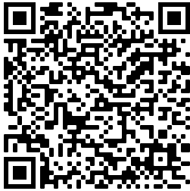
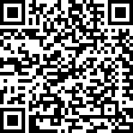
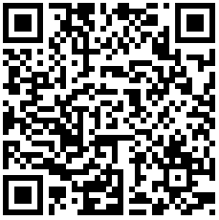
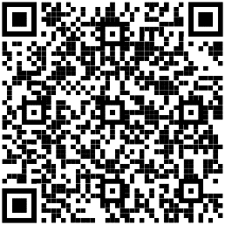
The following QR codes can be used to access the pages referenced in the previous slide.
February SYSCOM Training Summary
Start Date | Event
Mon, 14 Feb | Supervisor Academy: Current Supervisor Training, Cadre 2
Tue, 15 Feb | Live Webinar: Taking Charge of Your Learning and Development
Thu, 17 Feb | Live Webinar: Taking Charge of Your Learning and Development
Mon, 28 Feb | Supervisor Academy: New Supervisor Workshop, Cadre 2
Continual Learning
Competency Page
Executive Coaching Page
March Courses Open for Registration
Start Date | Event | Registration Deadline
Q2 Offerings – Dates TBD | Additional Q2 Offerings will be announced in February | Dates TBD
Career Compass Event Calendar
Conflict Management Competency Page

